Slide 1
Texture Mapping

Slide 2
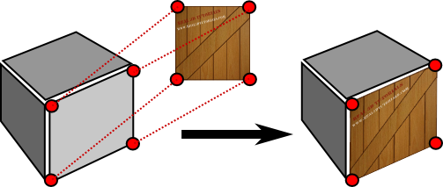
What is Texture Mapping
A graphic design process in which a two-dimensional (2-D) surface, called a texture map, is "wrapped around" a three-dimensional (3-D)object.
3-D object acquires a surface texture similar to that of the 2-D surface.
Texture mapping is the electronic equivalent of applying wallpaper, paint, or veneer to a real object.

Slide 3
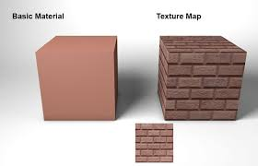
Why Texture Mapping
Adds realism to the scene
Draw a large brick wall without texturing, each brick must be drawn as a separate polygon
But With texturing a large flat wall is just a single polygon

Slide 4
Texture Mapping
Textures are simply rectangle arrays of data- color data, luminance data
The individual values in a texture array are often called texels
A vertex can have
A 3D position (x, y, z)
Normal (x, y, z)
Color?
A UV coordinate(s, t)- texture coordinate

Slide 5
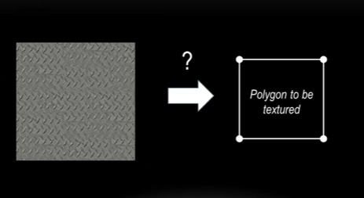
The Problem

Slide 6
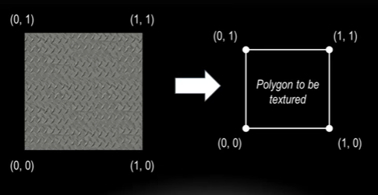
The Problem

Slide 7
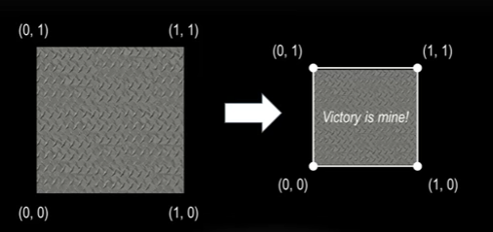
The Problem

Slide 8
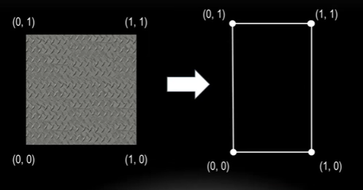
The Problem

Slide 9
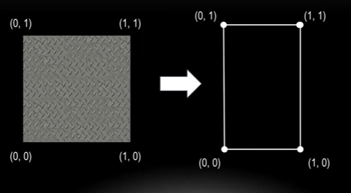
What if it’s Stretched

Slide 10
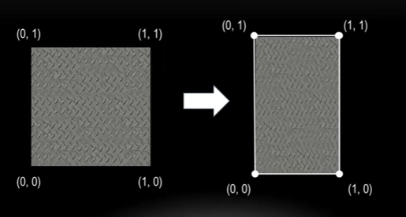
What if it’s Stretched

Slide 11
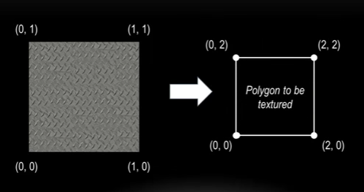
What Happen Now?

Slide 12
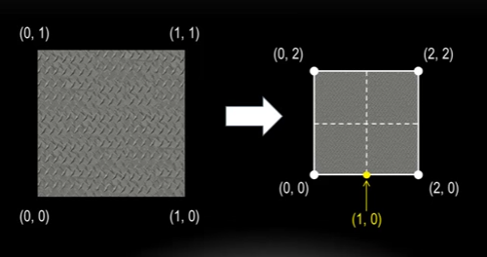
What Happen Now?

Slide 13
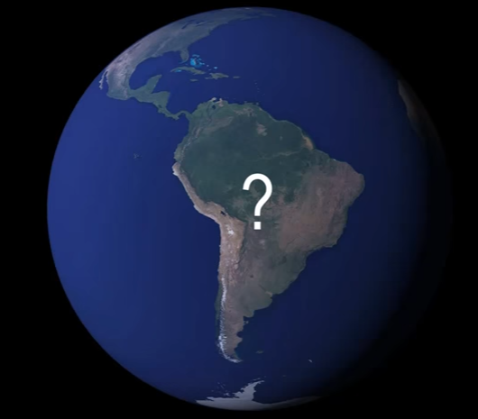
What Happen Now?

Slide 14
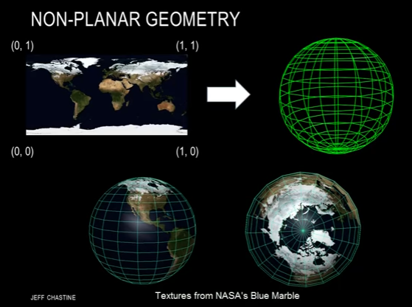
What Happen Now?

Slide 15
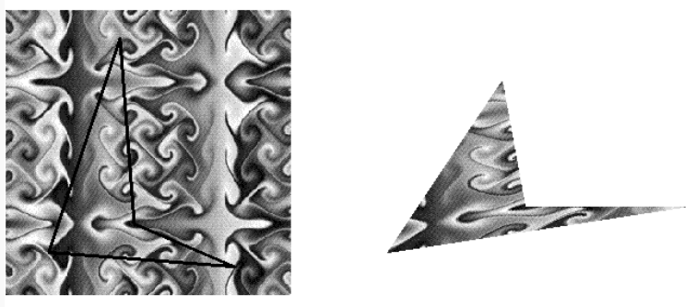
Another Problem(Transformation)

Slide 16
Another Problem(Transformation)
Texture is distorted to match the distortion of quadrilateral
Some of texels mapped to more than one fragment
Some fragments covered by multiple texels
To map texels to fragments, filter operation must be performed

Slide 17
Steps in Texture Mapping
Specify the texture
Indicated how the texture is to applied to each pixel
Enable texture mapping
Draw the scene, supplying both texture and geometric coordinates
Texture Mapping works only in RGB mode

Slide 18
Specify the Texture
The texture is a single image
Thought of as being two-dimensional but it can be one-dimensional
Four elements per texels (R, G, B, A)
Specify a single texture at many different resolution called mipmapping

Slide 19
Indicated how the texture is to applied to each pixel
Three possible functions for computing RGBA value
Simply use texture color as the final color- decal mode
Combining the effect of lighting with texturing
A constant color can be blended based on texture value

Slide 20
Enable texture mapping
Enable or disable using glEnable(constant) or glDisable(constant)
With symbolic constant GL_TEXTURE_1D, GL_TEXTURE_2D

Slide 21
Draw the scene, supplying both texture and geometric coordinates
Specify both texture co-ordinates and geometric coordinate
Texture coordinate range 0.0-1.0 in both directions
But geometric coordinate can be anything

Slide 22
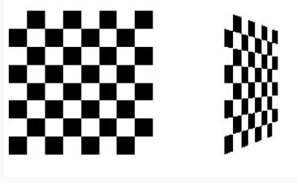
Sample Example

Slide 23
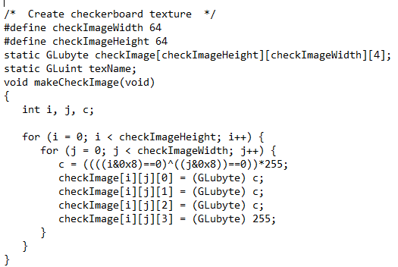
Texture Generation

Slide 24
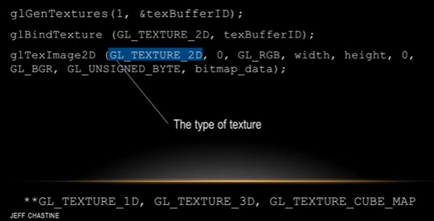
Texture Mapping Initialization

Slide 25
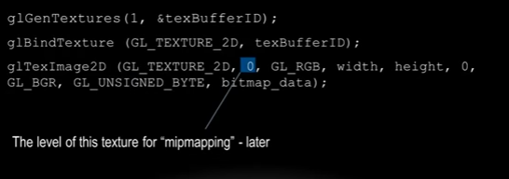
Texture Mapping Initialization

Slide 26
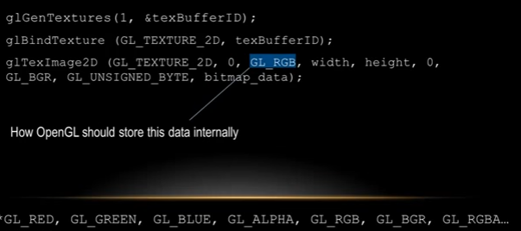
Texture Mapping Initialization

Slide 27
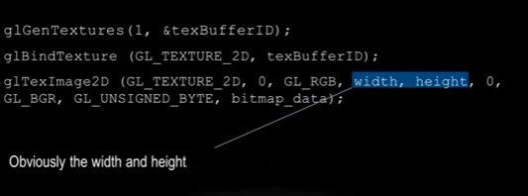
Texture Mapping Initialization

Slide 28
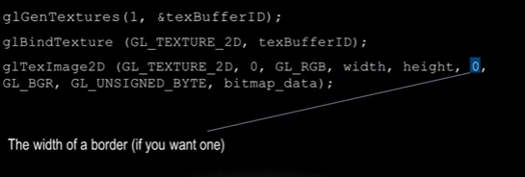
Texture Mapping Initialization

Slide 29
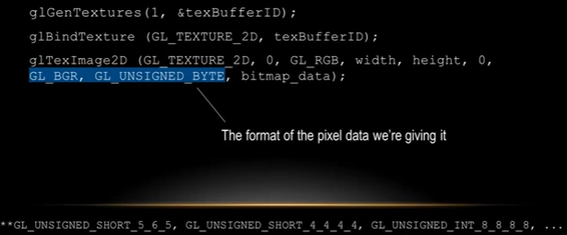
Texture Mapping Initialization

Slide 30
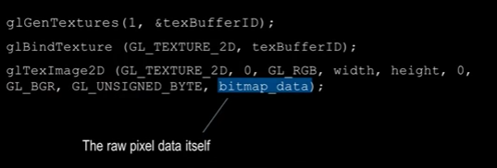
Texture Mapping Initialization

Slide 31
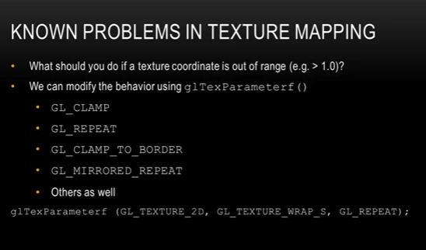

Slide 32
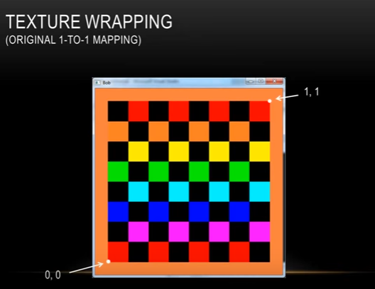

Slide 33
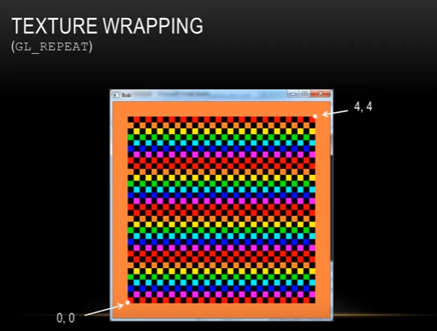

Slide 34
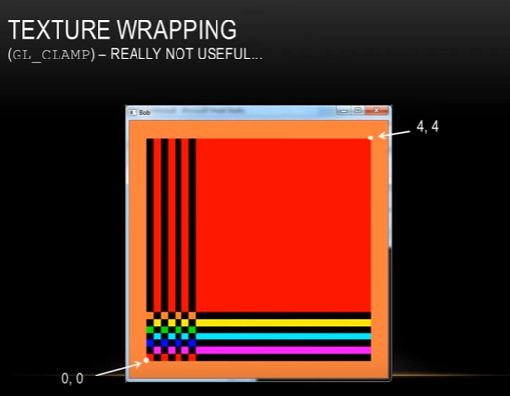

Slide 35
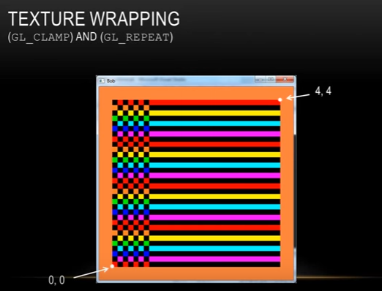

Slide 36
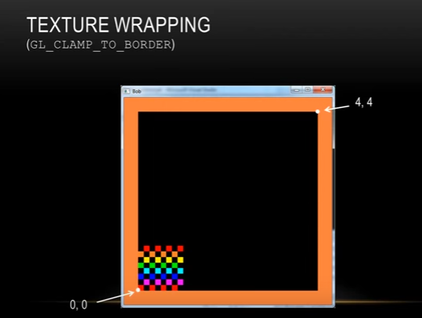

Slide 37
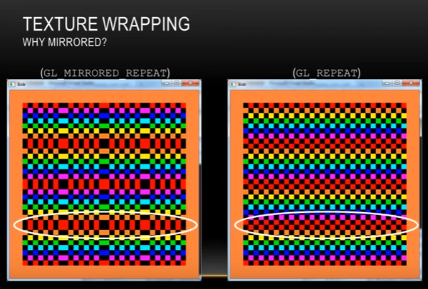

Slide 38
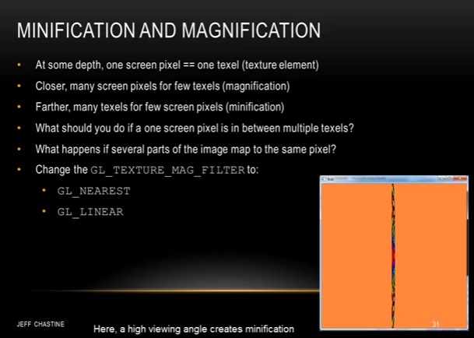

Slide 39
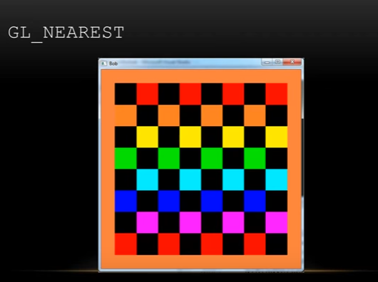

Slide 40
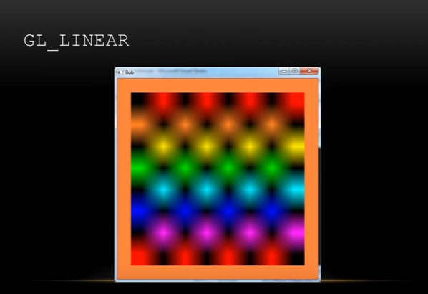

Slide 41
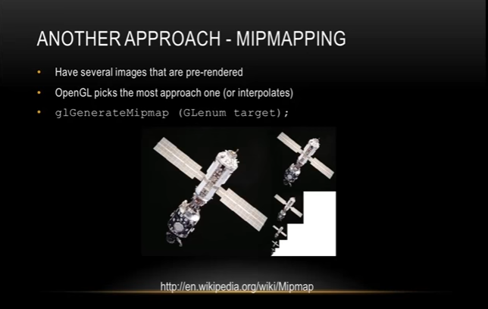

Slide 42
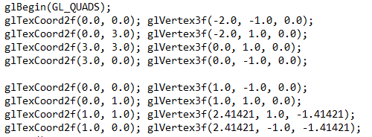
Display

